Slide 1
Corporate Presentation
April 2022
www.avalon-globocare.com
Nasdaq: AVCO

Slide 2
Forward-Looking Statements
Certain statements contained in this presentation may constitute “forward-looking statements”, which provide current expectations of future events based on certain assumptions and include any statement that does not directly relate to any historical or current fact. Actual results may differ materially from those indicated by such forward-looking statements as a result of various important factors as disclosed in our filings with the Securities and Exchange Commission located at their website (http://www.sec.gov). In addition to these factors, actual future performance, outcomes, and results may differ materially because of more general factors including (without limitation) general industry and market conditions and growth rates, economic conditions, and governmental and public policy changes. The forward-looking statements included in this presentation represent the Company's views as of the date of this presentation and these views could change. However, while the Company may elect to update these forward-looking statements at some point in the future, the Company specifically disclaims any obligation to do so. These forward-looking statements should not be relied upon as representing the Company's views as of any date subsequent to the date of this presentation.
2

Slide 3
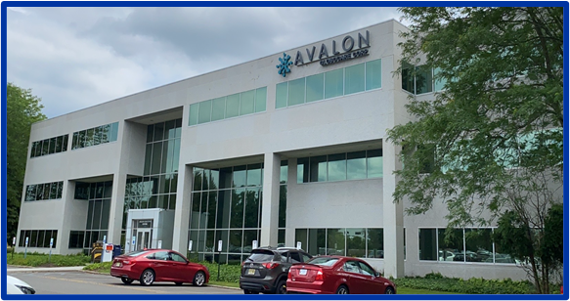
Corporate Overview
Avalon GloboCare Corp. (Nasdaq: AVCO) is a clinical-stage biotechnology company dedicated to develop and deliver innovative and transformative cellular technologies and therapeutics in the field of immuno-oncology and regenerative medicine
Founded in 2016 as OTC-QB company; successfully uplisted to NASDAQ in December 2018
Headquarters in Freehold, NJ; approx. 20 FTEs (including subsidiaries)
Core Technology Platforms:
Immune Effector Cell Therapies including CAR-T, CAR-NK, mRNA-based FLASH CAR™
Avalon Clinical-Grade Tissue-Specific Exosomes ( ACTEXTM )
QTY Code Protein Design/ AVA-TrapTM
S-Layer Nanotechnology / Mucosal Vaccine Development
3

Slide 4
Investment Highlights
Core technology platforms with applications in immuno-oncology, inflammation, COVID-19, and regenerative medicine
Leveraging platform through strategic partnering opportunities with academia and industries complementary to our R&D programs
Avalon – MIT: → QTY code protein design for decoy cytokine/chemokine receptors; novel therapeutic targets
Avalon – UPMC → novel bio-processor for mRNA CAR (FLASH-CARTM)
Avalon – BOKU → S-layer based mucosal candidate vaccine (COVID-19 and Flu)
Avalon – HydroPeptide → ACTEXTM
Strong proprietary technologies and IPs: Addressing multi-billion dollar, unmet cell and gene therapy markets worldwide
4

Slide 5
Major Clinical Base: Lu Daopei Hospital and Affiliates

Slide 6
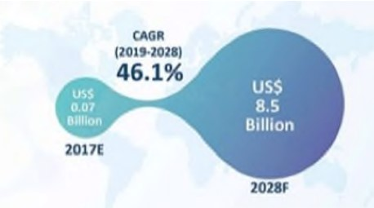
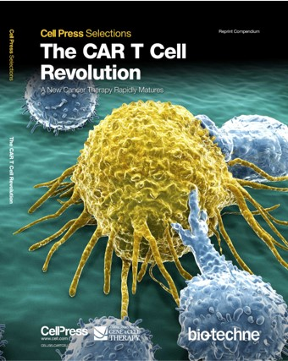
Core Technology Platform: CAR-T
Global CAR-T Market
Aug.2017 Gilead - Kite $11.9 Billion
Jan.2018 Celgene - Juno $9 Billion
Jan.2019 BMS - Celgene $74 Billion
Recent Mega M&A Deals
5 U.S. FDA-Approved Products
Kymriah Novartis 2017 (auto, CD19, B-ALL)
Yescarda Gilead/Kite 2017 (auto, CD19, lymphoma)
Tecartus Gilead/Kite 2020 (auto, CD19, lymphoma)
Breyanzi BMS/Juno 2021 (auto, CD19, MCL)
Abecma BMS/Bluebird 2021 (auto, BCMA, MM)
8

Slide 7
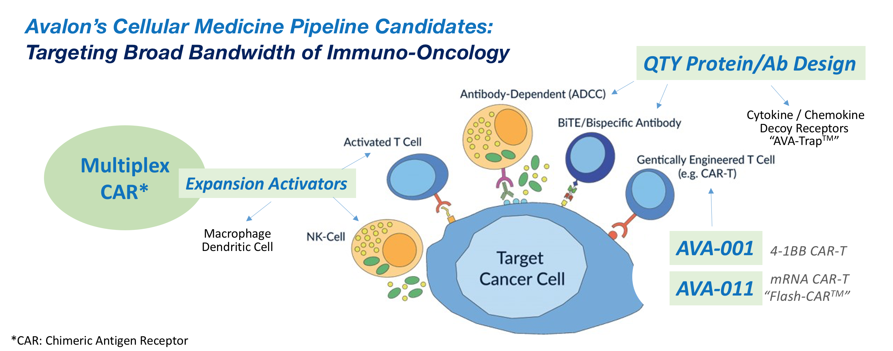
Spectrum of Avalon’s Cellular Technology Platforms
Avalon - MIT
CAR-NK
Cell

Slide 8
Avalon Academic-Industry Partnership

Slide 9
AVA-001 ( 4-1BB anti-CD19 CAR-T )

Slide 10
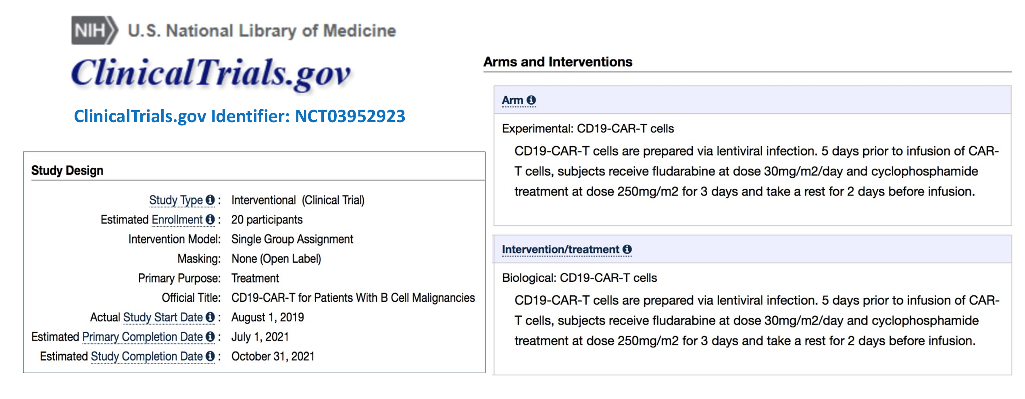
AVA-001 ( 4-1BB anti-CD19 CAR-T )

Slide 11
AVA-001 ( 4-1BB anti-CD19 CAR-T )

Slide 12
AVA-011 FLASH-CARTM -- A Multiplex, mRNA-CAR Platform
Lead Candidate: AVA-011 (Anti-CD19-CD22 CAR-T)
Auto- or Allo-CAR T targeting multiple tumor antigens
Proliferation inducer for in vivo expansion of CAR-T
Safety target/switch
Rapid bio-production time (1-2 days)
Inducible vector for tumor site specific expression of anti-tumor mediators to induce host response, such as checkpoint inhibitors, activators of Dendritic Cell, T Cells and NK cells
Simultaneous Activation of
Tumor-Attacking Immune Cells:
T Cells
Dendritic Cells
Natural Killer Cells
Macrophages
Currently at IND-enabling (process development) stage to generate cGMP clinical-grade AVA-011 CAR-T for upcoming first-in-human clinical trial

Slide 13
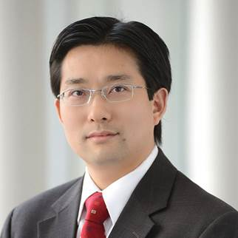
AVA-011 Universal (“off-the-shelf”) CAR-NK Cell Therapy
Tumor
Cell
Dr. Dongfang Liu
Member of Avalon’s SCAB

Slide 14
Avalon-MIT QTY Code Protein Design Platform

Slide 15
Avalon-MIT QTY Code Protein Design Platform

Slide 16
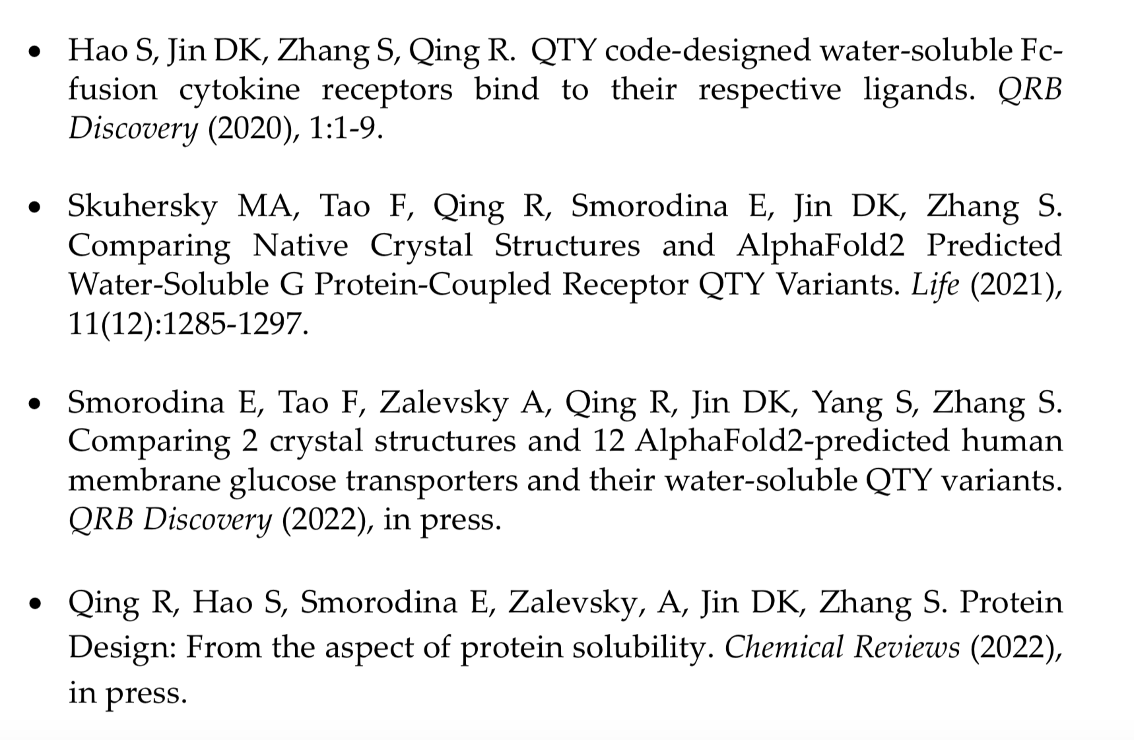
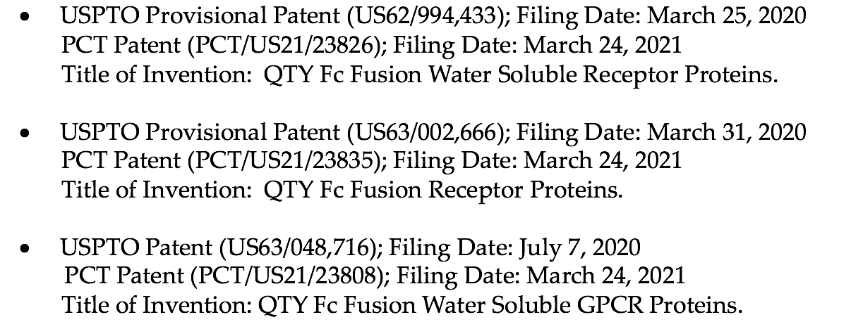
Avalon-MIT QTY Code Protein Design Platform
Accomplishments:
Joint IP Filing (MIT & Avalon)
Publications

Slide 17
Avalon-BOKU S-Layer Technology Platform

Slide 18
Avalon-BOKU S-Layer Technology Platform

Slide 19
Avalon-BOKU S-Layer Technology Platform

Slide 20
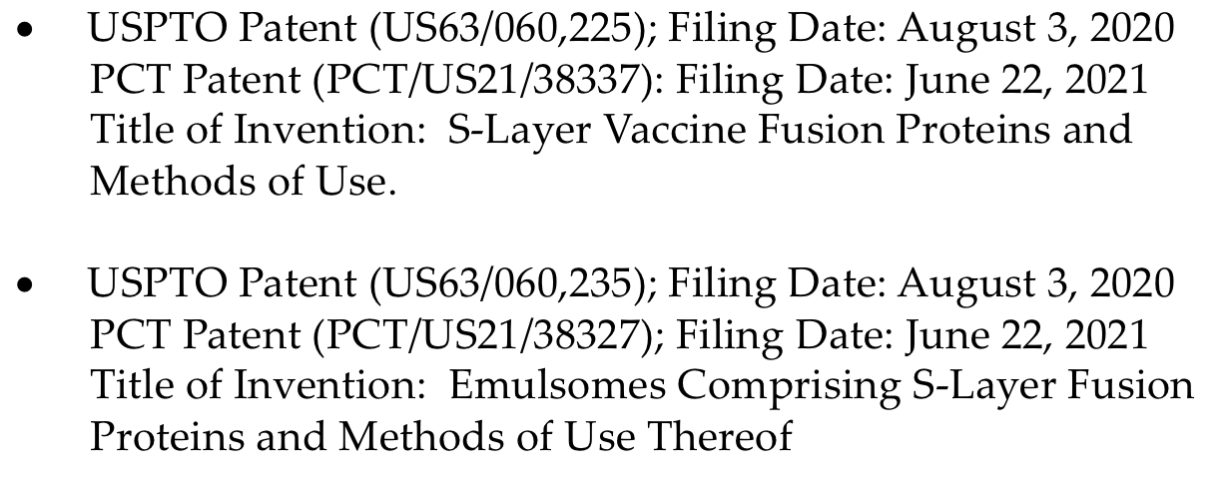
Avalon-BOKU S-Layer Technology Platform
Accomplishments:
Joint IP Filing
Publications
Zayni S, Damiati S, Moreno-Flores S, Amman F, Hofacker I, Jin DK, Ehmoser E-K. Enhancing the cell-free expression of native membrane proteins by in silico native optimization of the coding sequence – an experimental study of the human voltage-dependent anion channel. Membranes (2021), 11(10):741.
Matched Funding
Christian Doppler Laboratory for Synthetic Bioarchitecture
24

Slide 21
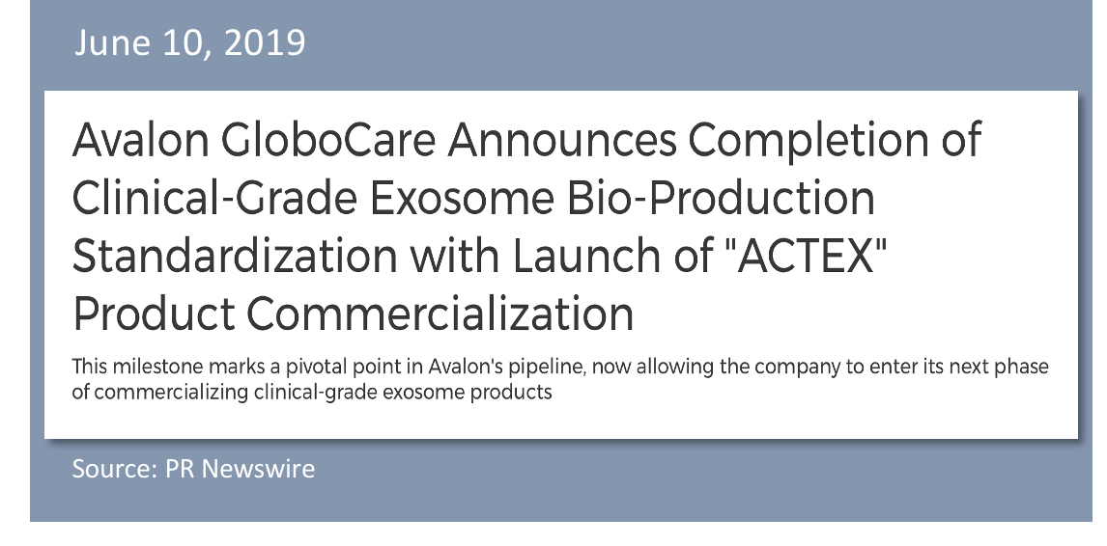
Avalon ACTEXTM Platform (Avalon Clinical-grade Tissue-specific Exosomes)

Slide 22
ACTEX™ Strategic Partnership with HydroPeptide

Slide 23
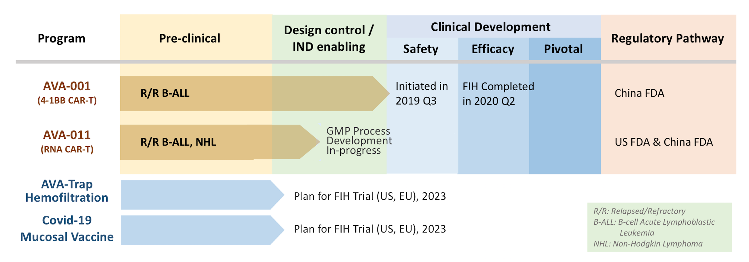
Avalon’s Clinical Programs – Timeline and Milestones

Slide 24
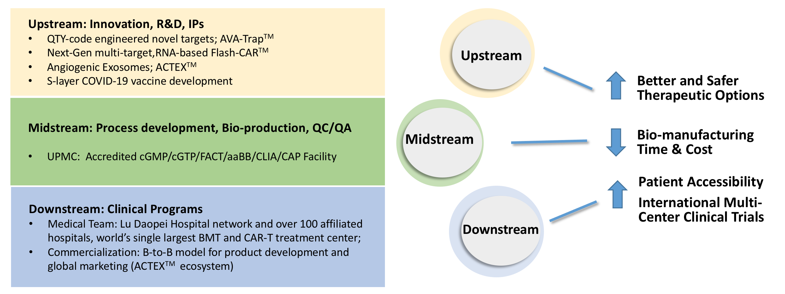
Avalon GloboCare Positions as Future Powerhouse in Cancer Immunotherapy and Cellular Medicine

Slide 25
Senior Management, Board of Directors, Advisors
Board of Directors
Senior Management Team
David Jin, M.D., Ph.D.
CEO, President, Co-founder, BoD
U.S. Licensed Physician; Former Medical Resident, Fellow and Faculty Member at Weill Cornell Medicine and New York-Presbyterian Hospital; Senior Clinician-Scientist at Ansary Stem Cell Institute; Former CMO of BioTime Inc. and OncoCyte Corporation
Meng Li
COO
Former WPP Group’s company executive
Luisa Ingargiola, MHA
CFO, Former CFO and BoD of several U.S. Public companies
Anna Azvolinsky, Ph.D.
Head, Media and Communication
Professor Daopei Lu, M.D.
Scientific Founder
Daniel Lu
Chairman of the Board
Congressman Billy Tauzin
Director; Former U.S. Congressman;
Former President of PhRMA
David Jin, M.D., Ph.D.
Director, CEO, President
Tevi Troy, Ph.D.
Director; Chairman of Nomination/Governance Committees
Former Deputy Director of U.S. Human Health Services
Yancen Lu
Director, Chairman of Compensation Committee
Founder and Managing Director, Pagoda Tree Group
Steven Sanders, J.D.
Director, Co-Chari of Compensation Committee
Founder of Ortoli Rosenstadt Law Firm, NYC
William Stilley
Director, Chairman of Audit Committee
CEO, Adial Pharmaceuticals (Nasdaq:ADIL)
Yue Charles Li
Director, M&A Taskforce
Team of Our Subsidiaries
David Jin, M.D., Ph.D.
CEO, Avactis (JV with Arbele)
John Luk, M.D., D.Sc.
President, Avactis
Steven Sukel, J.D.
Managing Director, Avalon RT9 Properties, LLC
Lucy Lu
President, Nanjing Epicon Biotech co., Ltd.
Meng Li
COO
Former WPP Group’s company executive
Luisa Ingargiola, MHA
CFO, Former CFO and BoD of several U.S. Public companies
Anna Azvolinsky, Ph.D.
Head, Media and Communication
Anna Azvolinsky, Ph.D.
Head, Media and Communication
Angela An
Vice President, APAC Business Development
Scientific & Clinical Advisory Board
Robert S. Langer, Sc.D.
Shahin Rafii, M.D.
Yen-Michael Hsu, M.D., Ph.D..
Peihua Peggy Lu, M.D
Dongfang Liu, Ph.D.
Uwe B. Sletyr, Ph.D.
-- Massachusetts Institute of Technology; David H. Koch Institute Professor
-- Weill Cornell Medicine; Director of Ansary Stem Cell Institute, HHMI
-- University of Pittsburgh Medical Center, Chief of Cellular Therapy
-- Executive President, Lu Daopei Hospital
-- Rutgers New Jersey Medical School; Director of Immunoassay Program
-- Professor Emeritus, University of Natural Resources and Life Sciences
Full Member, Austrian Academy of Sciences

Slide 26
Thank You
Investor Relations:
Crescendo Communications, LLC Email: avco@crescendo-ir.com Tel: 212-671-1020
www.avalon-globocare.com
Nasdaq: AVCO

